Slide 1
Capistrano
David Grayson
Las Vegas Ruby Meetup
2012-11-7

Slide 2
“Capistrano is a utility and framework for executing commands in parallel on multiple remote machines, via SSH.”
server1
ssh
server2
Local machine,
running capistrano
ssh
ssh
server3
ssh
server4

Slide 3
This talk will be about:
Capistrano in general
Deploying Rails

Slide 4

Before Capistrano
Logging in to multiple servers :(
Run commands with ssh utility.

Slide 5
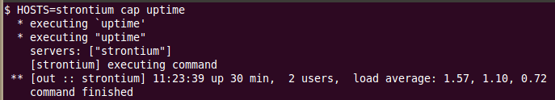
Simple Capfile #1: tasks
task "uptime" do
run "uptime"
end

Slide 6
Simple Capfile #2: hosts
task "uptime", :hosts => "strontium" do
run "uptime"
end

Slide 7
Simple Capfile #3: servers and roles
server "strontium", :app
task "uptime" do
run "uptime"
end

Slide 8
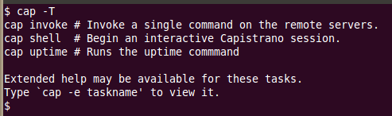
Simple Capfile #4: desc
server "strontium", :app
desc "Runs the uptime commmand"
task "uptime" do
run "uptime"
end

Slide 9
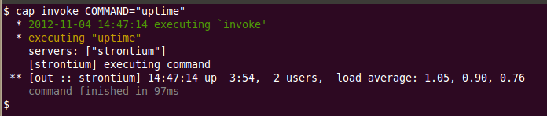
“invoke” task
Invokes a command on remote servers

Slide 10
Composition
task "uptime" do
run "uptime"
end
task "disk_usage" do
run %{df | awk '$6=="/"{print $5}'}
end
task "status" do
uptime
disk_usage
end

Slide 11


Slide 12
Before and after hooks
before 'status', 'uptime'
after 'status', 'disk_usage'

Slide 13
Namespaces
server "strontium", :app
namespace "status" do
task "default" do
uptime
disk_usage
end
task "uptime" do
run "uptime"
end
task "disk_usage" do
run %{df | awk '$6=="/"{print $5}'}
end
end
status
status:uptime
status:disk_usage

Slide 14
File transfer
upload
download
put
get
download "/etc/crontab",
"$CAPISTRANO:HOST$.crontab"

Slide 15
capture
version = capture("cat current/REVISION")
Important: only runs on ONE server!

Slide 16
stream
stream "tail -f shared/log/production.log"

Slide 17
run_locally
run_locally "git push"

Slide 18
Variables
Normal:
set(:root_password, "f00")
Deferred:
set(:root_password) do
Capistrano::CLI.password_prompt("Root password: ")
end
task :backup_database do
run "bkup --user=root --password=#{root_password}"
end

Slide 19
Variables (continued)
set
unset
exist?
fetch

Slide 20
Special Significant Variables
https://github.com/capistrano/capistrano/wiki/2.x-Significant-Configuration-Variables
default_environment
shared_children

Slide 21
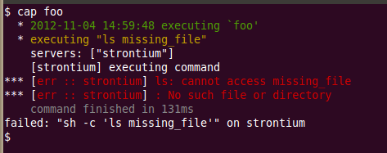
Errors
Based on command return code
task "foo" do
run "ls missing_file"
end

Slide 22
Transactions
task "update" do
transaction do
copy
start
end
end
task "copy" do
on_rollback { run "rm -fv b d" }
run "cp a b"
run "cp c d"
end

Slide 23
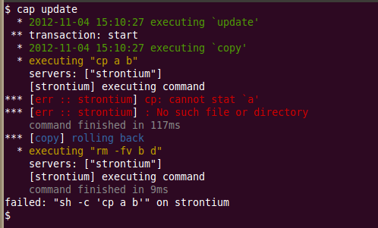

Slide 24
Deploying Rails
Online tutorials
Check out https://github.com/capistrano/capistrano/blob/master/lib/capistrano/recipes/deploy.rb
For assets, check out:
https://github.com/capistrano/capistrano/blob/master/lib/capistrano/recipes/deploy/assets.rb
WARNING: deploy:rollback doesn't roll back assets.

Slide 25
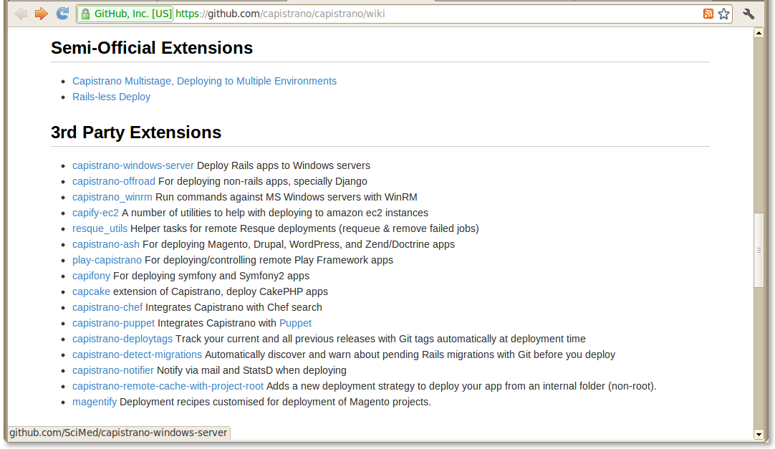

Slide 26
The End

